Slide 1
National Highway Traffic Safety Administration
Vehicles and Parts Recall Data
https://www.kaggle.com/nhtsa/safety-recalls
By Nick DeChant
https://www.linkedin.com/in/nicholasdechant/

Slide 2
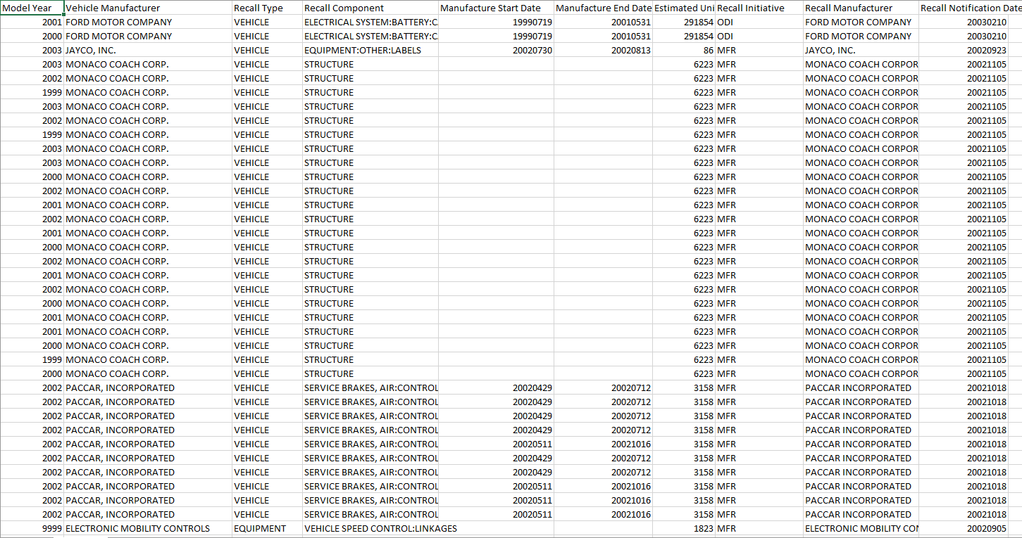
Snippet of raw data:

Slide 3
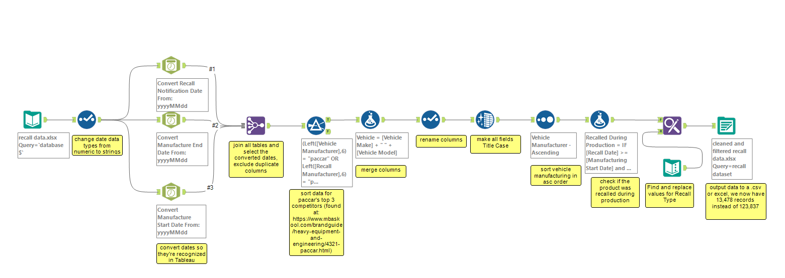
Using Alteryx to transform and clean data

Slide 4
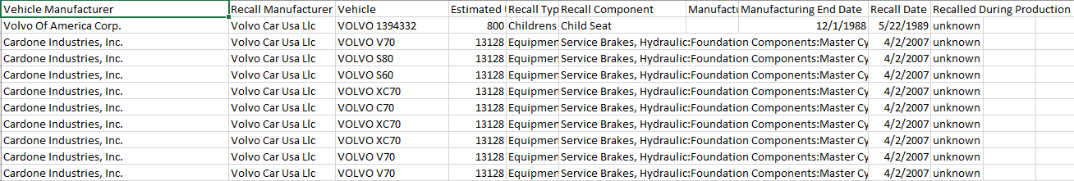
New data:
Filtered for PACCAR, as well as their top three competitors.
Includes if vehicle was recalled during or after production.
Dates can be recognized by Tableau.
13,478 records of data instead of 123,837.

Slide 5
Data Reporting With Tableau
We can analyze all manufacturer recalls between 1966 to 2017.
Analyze recalls by year specific.
‘Drill down’ and see which vehicles and components were recalled each year.
Analyze if component was recalled during production and which company and vehicle models the part belongs to.
Answer various questions: For example, what was the most recalled part for Paccar in year 2015 and which vehicles had to be recalled with this part?

Slide 6
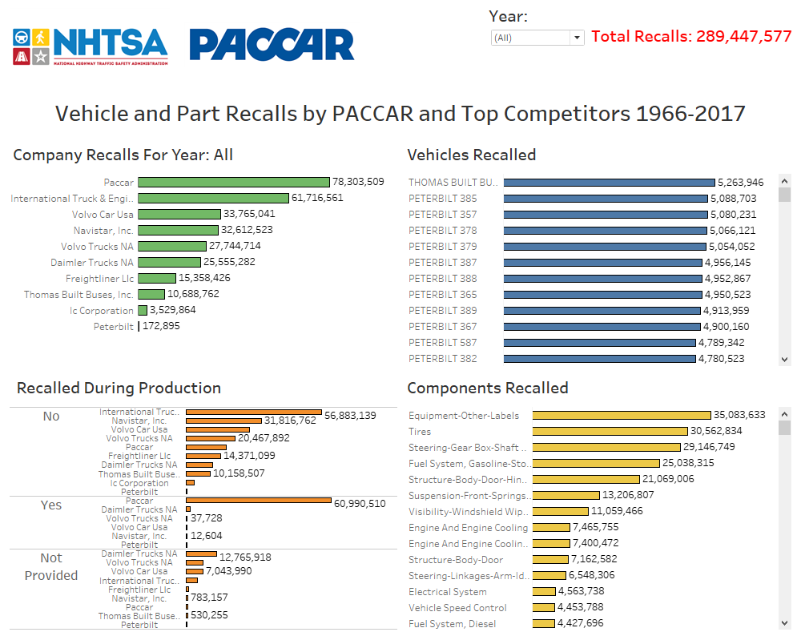

Slide 7
Link to project:
https://public.tableau.com/profile/nick8620#!/vizhome/VehicleRecalls/Recalls?publish=yes

Slide 8
Nick DeChant nickdechant@outlook.com 425-922-1585 https://www.linkedin.com/in/nicholasdechant/
Thank you for viewing!

